Slide 1

Restaurant & Consumer Data Project!
Presented By:
Tharun Thanugula

Slide 2
Agenda
Objective of the Project
ER Diagram and schema explanation
Key analysis questions (use cases)
SQL query results with screenshots or summaries
Final business insights and recommendations
Conclusion (Key finding overall)
Q&A Slide
Your Experience/Challenges working on SQL – Data Analysis Project.

Slide 3
OBJECTIVE OF THE PROJECT
The main objective of the Restaurant and Consumer Data Management System is to design a relational database that efficiently stores and analyzes information about consumers, restaurants, cuisines, and ratings.
The project aims to identify top-rated restaurants, understand customer preferences, and evaluate restaurant performance using SQL queries.
By applying advanced SQL techniques like joins, subqueries, CTEs, and stored procedures, it generates meaningful insights for better decision-making.
The system helps restaurant owners improve service quality and assists consumers in finding restaurants that match their preferences, ultimately promoting data-driven strategies and enhanced dining experiences.

Slide 4
ER Diagram and schema explanation
The ER diagram represents relationships between Consumers, Restaurants, and their Ratings.
The Consumers table stores personal and lifestyle details, while Consumer_Preferences links consumers with their favorite cuisines.
The Restaurants table contains information like location, price, and services. Each restaurant can serve multiple cuisines, stored in Restaurant_Cuisines.
The Ratings table connects consumers and restaurants, showing their overall, food, and service ratings.
Relationships include one-to-many between Consumers and Ratings, and Restaurants and Ratings, and many-to-many between Consumers and Cuisines via Consumer_Preferences.

Slide 5
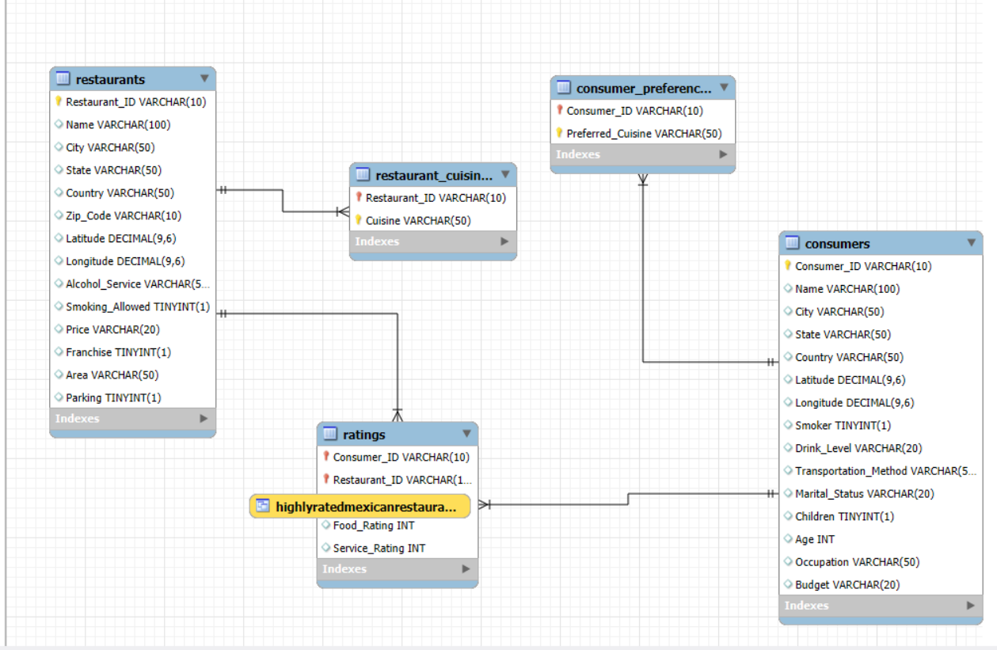
ER DIAGRAM OF THIS PROJECT

Slide 6
Key analysis questions (use cases)
The project enables analysis of consumer behavior, restaurant performance, and cuisine preferences.
It identifies high-value consumers, their preferred cuisines, and spending segments (Low, Medium, High).
Restaurants are evaluated based on overall, food, and service ratings, highlighting top performers and those needing improvement.
Insights include popular cuisines per city, gaps between preferences and offerings, and consumers’ rating patterns compared to averages. Advanced use cases include ranking restaurants for each consumer, tracking sequential ratings, and identifying top consumers.
Operationally, the system supports targeted promotions, optimized restaurant offerings, and strategic decisions to improve consumer satisfaction and business growth.

Slide 8
SQL query results with screenshots or summaries
Restaurant & Consumer Analysis – Key Insights
Category | Details / Examples
Consumers in Cuernavaca | C001: Alice (28, Student), C002: Bob (35, Engineer), C005: Elena (32, Teacher)
Students Who Smoke | C001 (28, Student)
Restaurants – Wine & Beer, Medium Price | El Camino Real, Cuernavaca
Highly Satisfactory Ratings (Overall=2) | R001 by C001 & C005, R002 by C002, R003 by C003
Restaurants Below Avg Food Rating | Burger Hub (Cuernavaca), La Trattoria (Cuernavaca), Pizza Plaza (Ciudad Victoria)
Top 2 Highest-Rated Restaurants per Cuisine | Mexican: El Camino Real & Taco Loco; Italian: La Trattoria; American: Burger Hub; Pizzeria: Pizza Plaza
Consumer-Restaurant Interaction | C002: La Trattoria (2, At Avg), Burger Hub (0, Below Avg)

Slide 9
Final business insights and recommendations
Most active consumers are in Cuernavaca, with students and budget-conscious users shaping dining trends.
Mexican and Italian cuisines are highly preferred, but some consumer preferences lack matching restaurants.
Top-rated restaurants include El Camino Real and Taco Loco, while Burger Hub and La Trattoria need improvement in food and service.
Consumer engagement patterns reveal loyalty and dissatisfaction trends. Operational gaps, such as limited parking or lack of alcohol service, affect satisfaction.
Recommendations include expanding popular cuisines, improving underperforming restaurants, targeting promotions to high-value consumers, enhancing facilities
regularly monitoring feedback to optimize menu, pricing, and overall service for higher satisfaction and business growth.

Slide 10
TABLE OF ABOVE SLIDE INFO
1
Category | Details / Examples
Consumers in Cuernavaca | C001: Alice (28, Student), C002: Bob (35, Engineer), C005: Elena (32, Teacher)
Students Who Smoke | C001 (28, Student)
Restaurants – Wine & Beer, Medium Price | El Camino Real, Cuernavaca
Highly Satisfactory Ratings (Overall=2) | R001 by C001 & C005, R002 by C002, R003 by C003
Restaurants Below Avg Food Rating | Burger Hub (Cuernavaca), La Trattoria (Cuernavaca), Pizza Plaza (Ciudad Victoria)
Top 2 Highest-Rated Restaurants per Cuisine | Mexican: El Camino Real & Taco Loco; Italian: La Trattoria; American: Burger Hub; Pizzeria: Pizza Plaza
Consumer-Restaurant Interaction | C002: La Trattoria (2, At Avg), Burger Hub (0, Below Avg)
Business Insights | Consumers influence trends by location, age, and budget; Mexican & Italian cuisines dominate; top performers: El Camino Real & Taco Loco; underperformers: Burger Hub, La Trattoria.
Recommendations | Expand popular cuisines, improve food/service in underperforming restaurants, target promotions to high-value consumers, enhance facilities, monitor feedback to optimize menu, pricing, and service.

Slide 11
Conclusion (Key finding overall)
The analysis reveals that consumer behavior is heavily influenced by location, age, occupation, and budget.
Cuernavaca hosts the most active consumers, with students and budget-conscious users shaping dining trends.
Mexican and Italian cuisines are highly preferred, but some consumer preferences lack sufficient restaurant options.
El Camino Real and Taco Loco are consistently top-rated, while Burger Hub and La Trattoria require improvements in food and service.
Consumer engagement patterns highlight loyalty and dissatisfaction trends.
Operational factors like parking, pricing, and alcohol service impact satisfaction.
Overall, aligning restaurant offerings with consumer preferences and improving service quality can drive higher satisfaction and business growth.

Slide 12
Q&A – Restaurant & Consumer Analysis Project
Q1: What was the main objective of the project?
Answer: To analyze consumer behavior, restaurant performance, and
cuisine preferences to improve service, offerings, and customer satisfaction.
Q2: Which consumers were most active?
Answer: Consumers in Cuernavaca, especially students and
budget-conscious users.
Q3: Which restaurants performed best and worst?
Answer: Top-rated: El Camino Real, Taco Loco. Underperforming: Burger Hub,
La Trattoria.
Q4: Which cuisines were most preferred?
Answer: Mexican and Italian.
Q5: Key recommendation for businesses?
Answer: Expand popular cuisines, improve food/service, target promotions,
enhance facilities, and monitor feedback.

Slide 13
Experience/Challenges working on SQL – Data Analysis Project.
EXPERIENCE
Gained hands-on experience designing relational databases
with multiple tables and relationships.
Practiced advanced SQL queries including JOINs, subqueries,
CTEs, window functions, views, and stored procedures.
Developed insights from consumer behavior, restaurant performance, and cuisine preferences using real data.
Learned to segment consumers, rank restaurants, and analyze ratings to support business decisions.

Slide 14
CHALLENGES
Handling complex queries with multiple joins and aggregations.
Ensuring data consistency across tables with foreign keys.
Writing CTEs and window functions correctly for ranking and performance analysis.
Interpreting results into meaningful business insights.

Slide 15

THANK YOU

